Slide 1
Analysis of Venue Places of Ankara Fatma Betül Akyol 24/04/2021

Slide 2
Introduction/Business Problem
Ankara is the capital city of Turkey. It includes lots of universities and workplaces. Students and workers are the important customers of restaurants.
Students and workers search good places to eat or drink something. Target users are:
Stakeholders who wants to open a restaurant in Ankara
Someone who searches a good cafe or restaurant to eat or drink something.
Tourists who come to Ankara and searching a hotel for accommodation hotel venues
Someone who are searching good café or restaurant places in Ankara and tourists or newcomers who come to Ankara and search for a place for accommodation may be interested.

Slide 3
Data
Data which is accessible with using Foursquare API
Kızılay and Bahçelievler nearby venues data that is retrieved by using Foursquare API
Rating of each restaurant venue with radius 500 meters.

Slide 4
Methodology
Categories of places that are in 500 radius meters are founded.
Clustering operation is done according to these categories.
Restaurant categories were found and visualized on the map.
The rating value if exists was found and saved in a dataframe.
Place that has highest rating value is shown with red marker and other places is shown with blue marker.

Slide 5
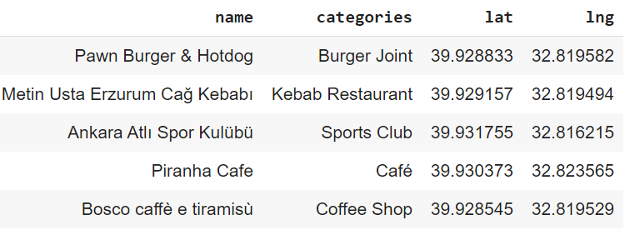
Venues in Bahçelievler, Ankara
Venues and categories of venues in Bahçelievler

Slide 6
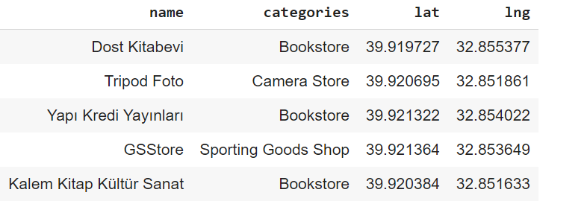
Venues in Kızılay, Ankara
Venues and categories of venues in Kızılay.

Slide 7
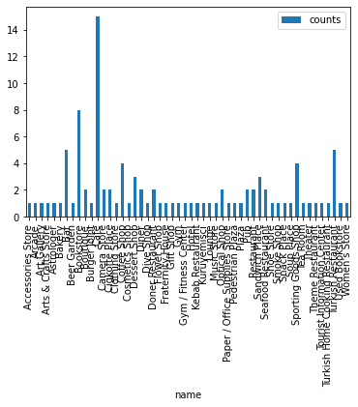
Data Analysis (1/2)
The number of places that grouped according to categories in Kızılay, Ankara.
Café category has maximum number of places.

Slide 8
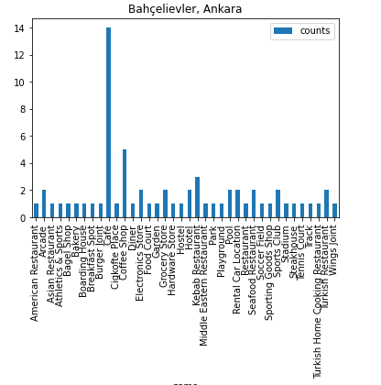
Data Analysis (2/2)
The number of places that grouped according to categories in Bahçelievler, Ankara.
Café category has maximum number of places.

Slide 9
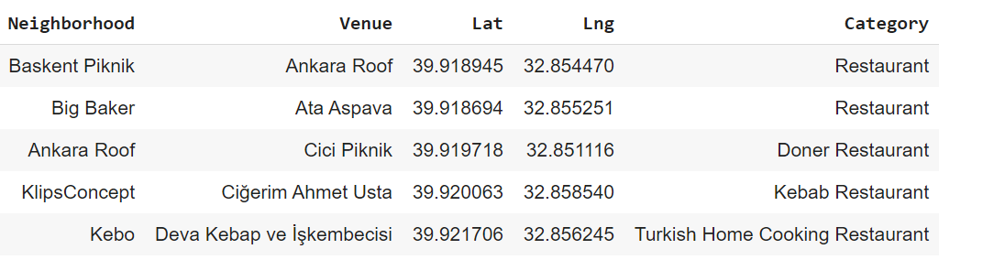
Analysis of restaurant venues
Restaurant catefory includes:
Restaurant
Doner Restaurant
Kebab Restaurant
Turkish Home Cooking Restaurant

Slide 10
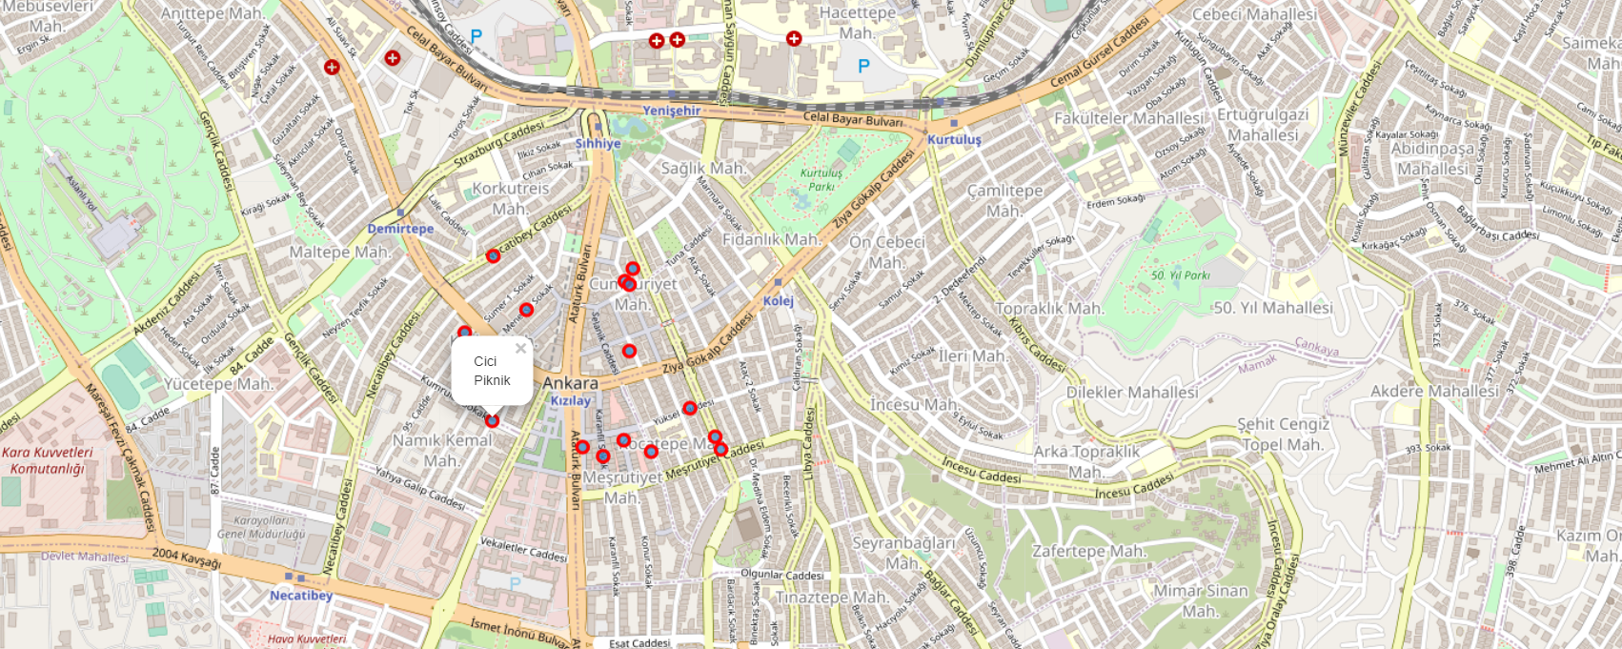
Visualization of restaurant venues in Ankara
Mean = -0.25
p < 0.001
Mean = 1.02

Slide 11
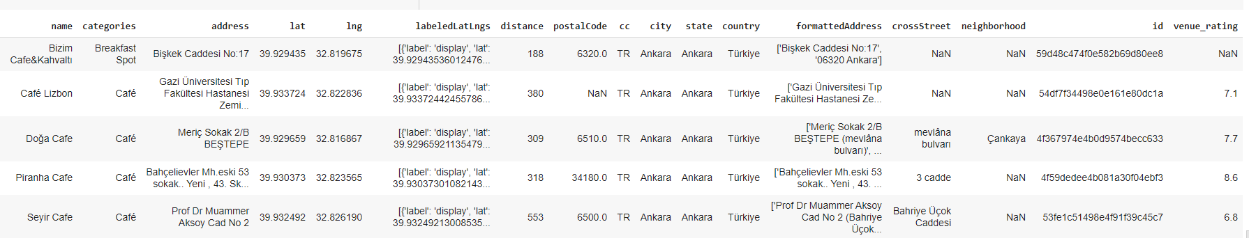
Analysis of cafe venues
Cafe venues has been examined seperately. The rating value if exists was found and saved in a dataframe.
If location has no rating value, it’s rating value saved as 'NaN'.

Slide 12
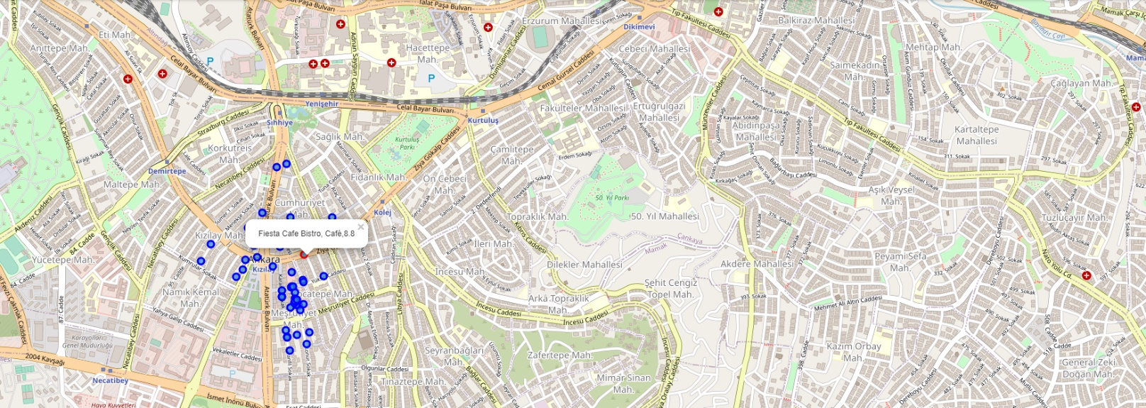
Visualization of cafe venues and ratings in Kızılay, Ankara

Slide 13
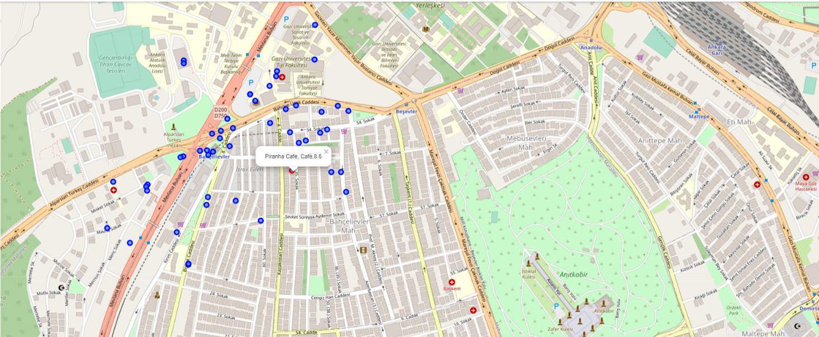
Visualization of cafe venues and ratings in Bahçelievler, Ankara

Slide 14
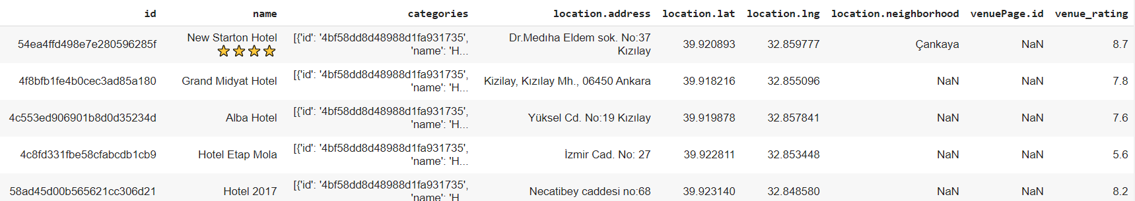
Analysis of hotel venues
Hotel venues has been examined seperately. The rating value if exists was found and saved in a dataframe.
If hotel has no rating value, it’s rating value saved as 'NaN'.

Slide 15
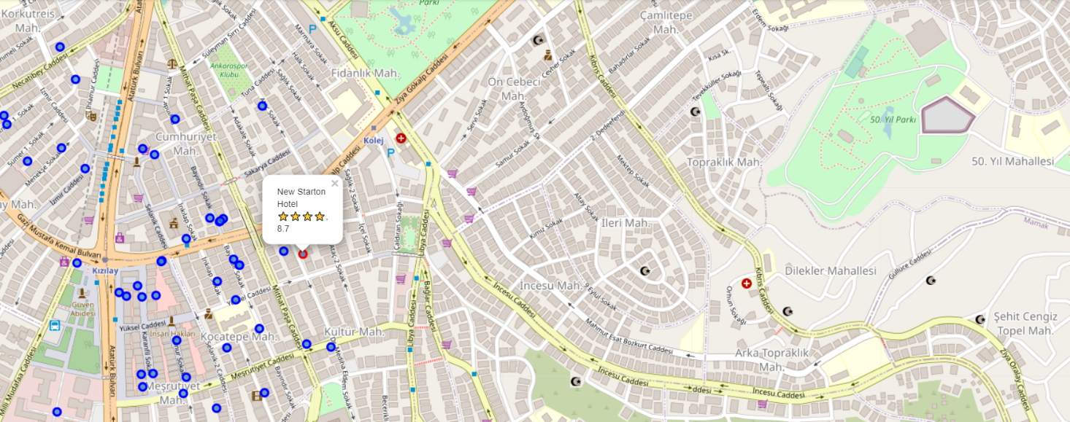
Visualization of hotel venues and ratings in Kızılay, Ankara

Slide 16
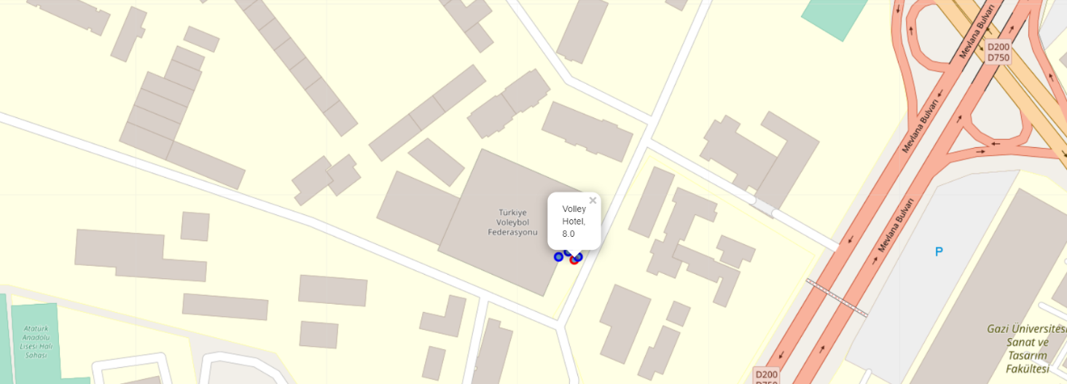
Visualization of hotel venues and ratings in Bahçelievler, Ankara

Slide 17
Results and discussions
Results show that cafe, coffe shops and restaurant are most popular places both Kızılay and Bahçelievler in Ankara. For this reason, if someone who wants to open cafe or coffe shops may open in the Bahçelievler or Kızılay.
Results showed that the number of restaurant venues are less than total number of cafe and coffe shops. But more than other categories.
Rating values of cafe venues are extracted and showed on the map with rating values. Venue that has highest rating shown with different color from others.
Kızılay have much more hotel venues according to Bahçelievler and the fullness of the rating values of Kızılay’ hotel venues is more than Bahçelievler's hotel venues rating values.

Slide 18
Conclusions
Two favorite places of Ankara which are Kızılay and Bahçelievler are analyzed.
Restaurants, doner and kebab restaurants are found and visualized in the map.
For someone who is searching good cafe or hotels in Bahçelievler or Kızılay if exists the rating of each cafe venue was found and visualized on the map.
This project will be useful for someone who is searching good cafe, restaurant or hotel in Ankara.
This project may be extend with analysis of all places of Ankara.

